Slide 1
Transfer Learning And Data Augmentation
Transfer Learning

Slide 2
Transfer learning is transferring the knowledge of one model to preform a new task.
Training deep neural networks can be computational and time-consuming and this is where transfer learning comes to rescue.
The whole idea revolves around using lower layers of pre-trained CNN model and adding additional layers that will customize the architecture for the specific problems under examination.

Slide 3
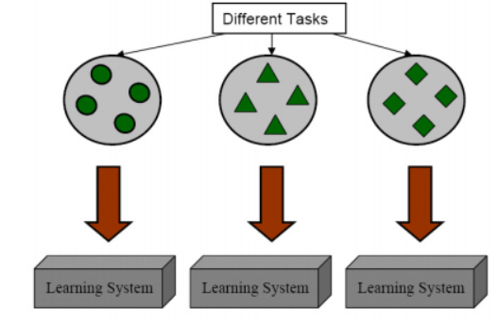
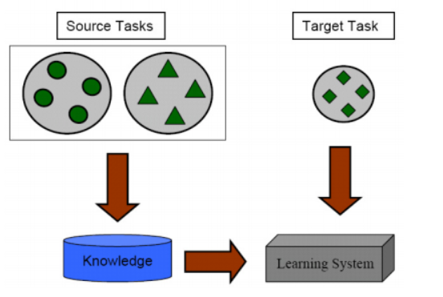
Machine Learning vs Transfer Learning

Slide 4
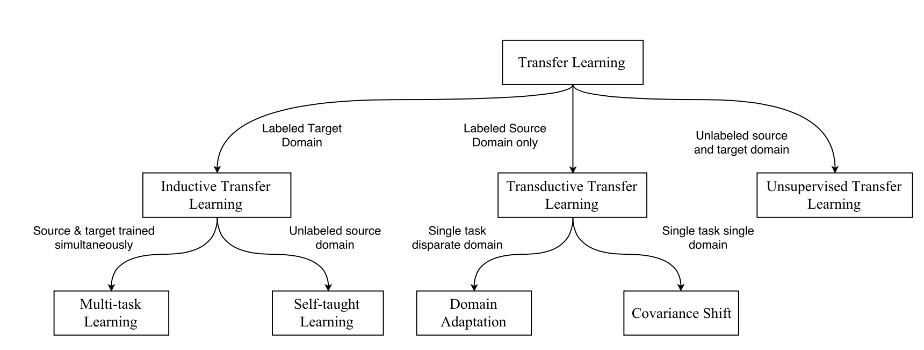
Transfer Learning Types
Inductive – Adapts existing supervised training model on new labeled dataset.
Transductive - Adapt existing supervised training model on new unlabeled dataset.
Unsupervised - Adapt existing unsupervised training model on new unlabeled dataset.

Slide 5
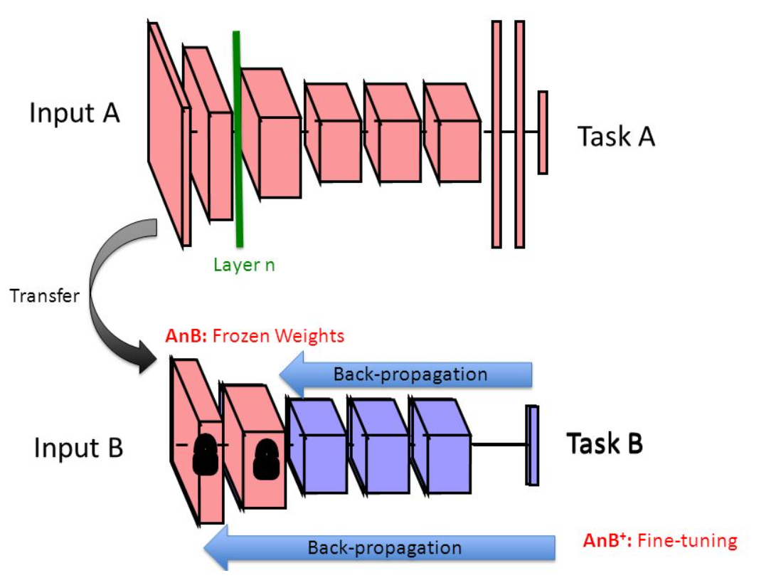
Transfer Learning Process
Start with pre-trained network
Partition network into:
Featurizers: identify which layers to keep
Classifiers: identify which layers to replace
Re-train classifier layers with new data
Unfreeze weights and fine-tune whole network with smaller learning rate

Slide 6
Fine tunning the model
Ref: https://cs231n.github.io/transfer-learning/
Data Set size | Data Set Similarity | Recommendation
Large | Very different | Train Model from scratch, initialize weights from Model A
Large | Similar | Ok to fine tune(Reduces overfitting)
Small | Very different | Train classifier using the earlier layers
Small | Similar | Don’t fine tune it is likely to over fit. Train a linear classifier instead

Slide 7
Demerits
Transfer learning will not work when the high-level features learned by the bottom layers are not sufficient to differentiate the classes in your problem. For example, a pre-trained model may be very good at identifying a door but not whether a door is closed or open. However In such a case, you will have to retrain more layers of the model or use features from earlier layers.
When datasets are not similar, features transfer poorly.

Slide 8
Data Augmentation
Data Augmentation is a technique that can be used to artificially expand the size of a training set by creating modified data from the existing one.
Data augmentation is used in one of the following scenarios:
Prevent overfitting,
The initial dataset is too small to train on,
Get the better performance from your model.
Ref : http://cs231n.stanford.edu/reports/2017/pdfs/300.pdf

Slide 9
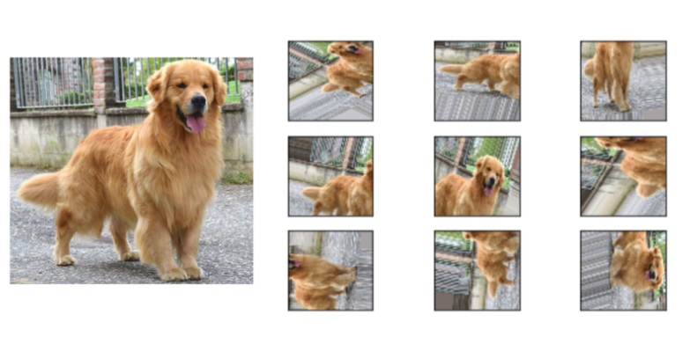
Data augmentation techniques
Various changes can be applied to the initial image data:
Geometric transformations – you can randomly flip, crop, rotate or translate images.
Color space transformations – change RGB color channels, intensify any color
Kernel filters – sharpen or blur an image
Random Erasing – delete a part of the initial image
Mixing images – basically, mix images with one another. Might be counterintuitive but it works

